Slide 1
Машинный перевод
Подготовила Лежебокова М.В.

Slide 2
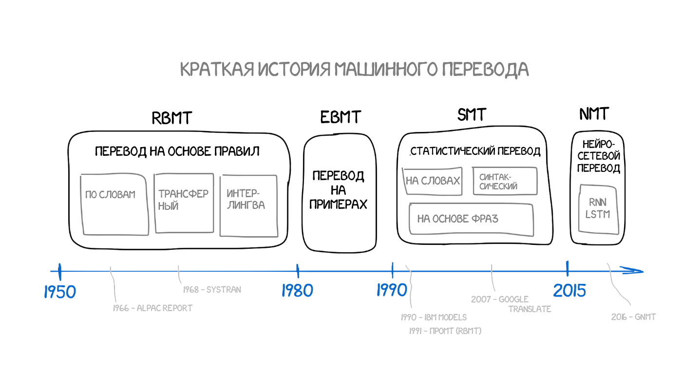

Slide 3
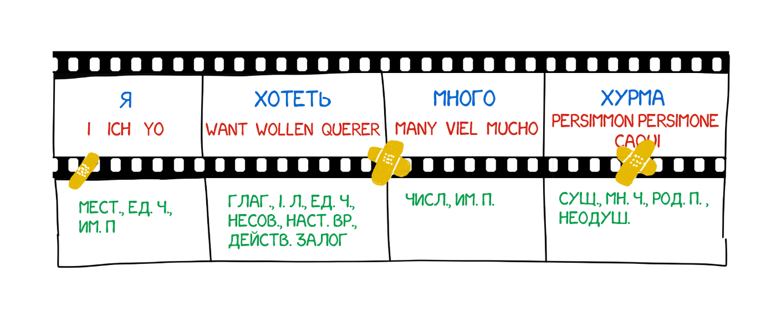

Slide 4
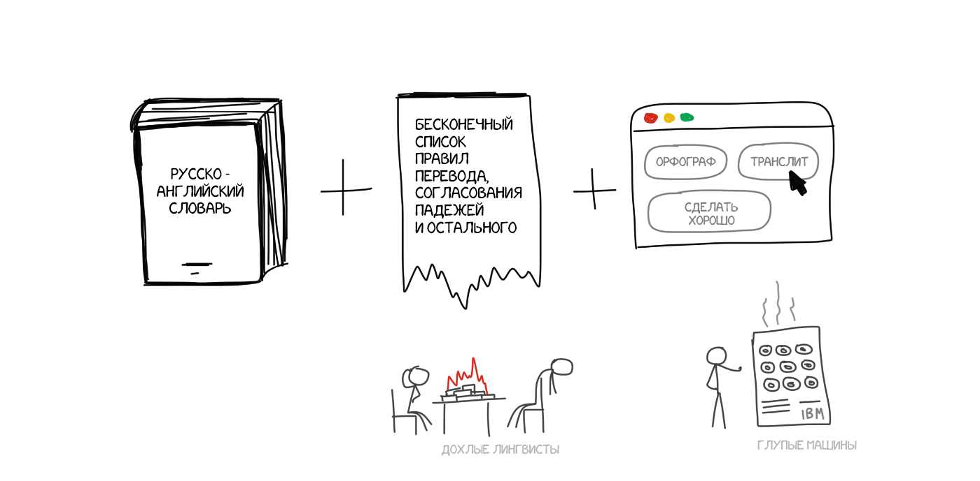
Rule-based Machine Translation (RBMT)

Slide 5
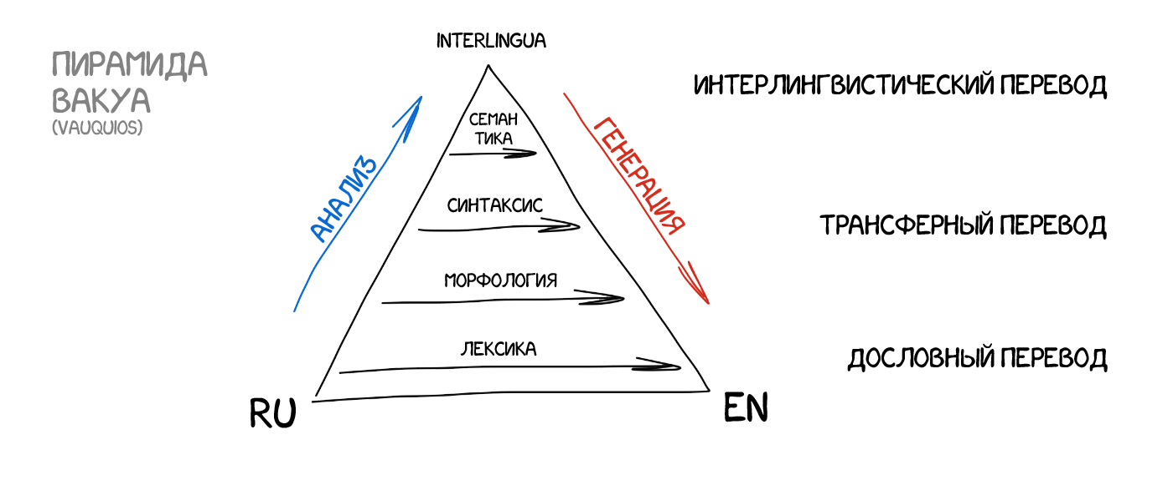

Slide 6
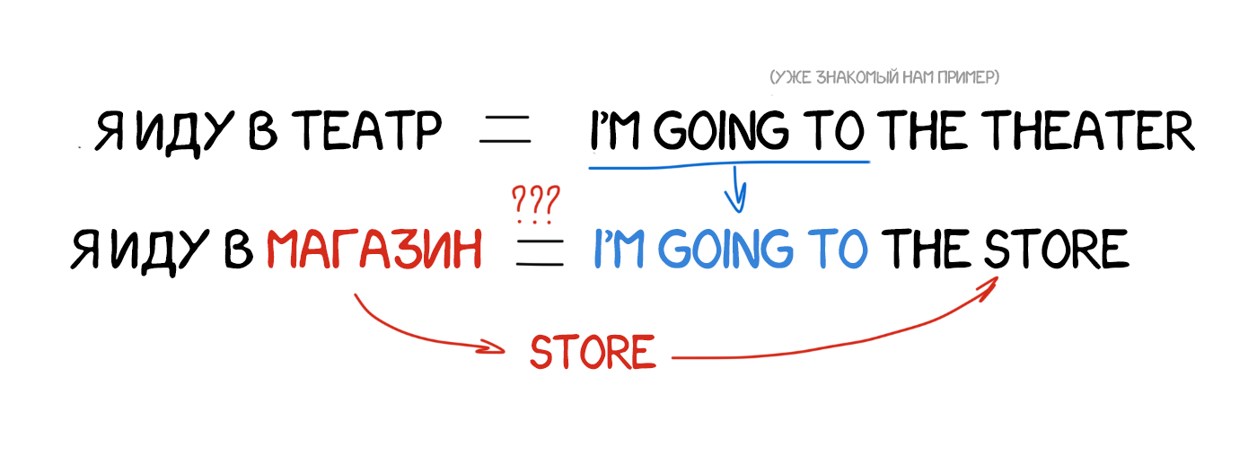
Example-based Machine Translation (EBMT)

Slide 7
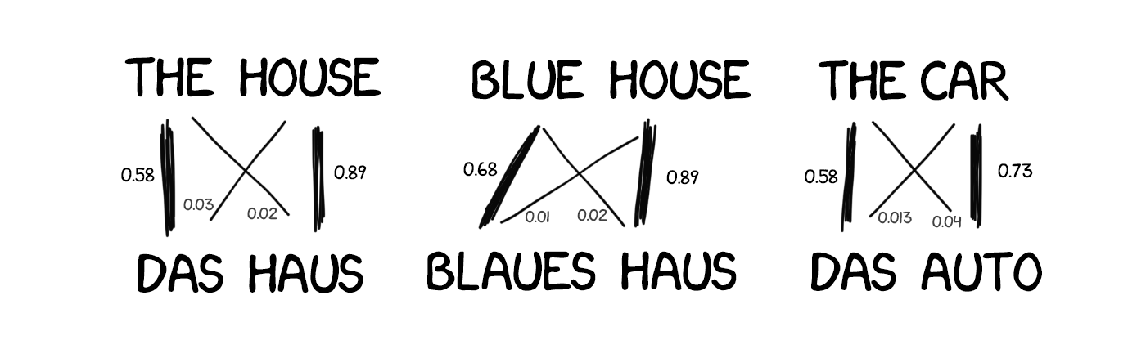
Statistical Machine Translation (SMT)

Slide 8
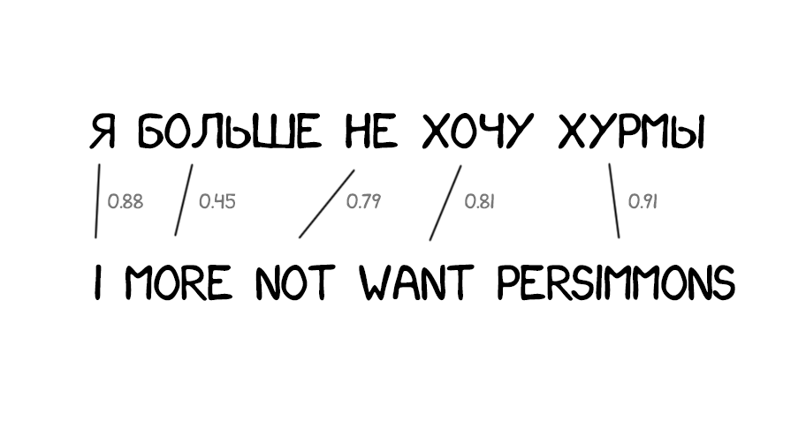
Word-based SMT (Model 1)

Slide 9
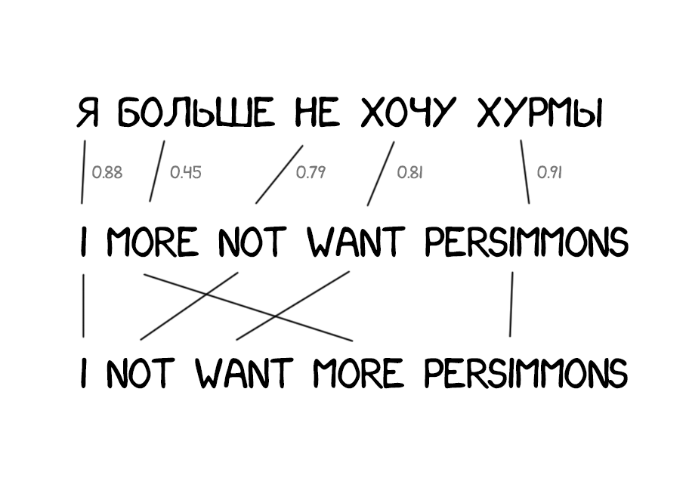
Word-based SMT (Model 2)

Slide 10
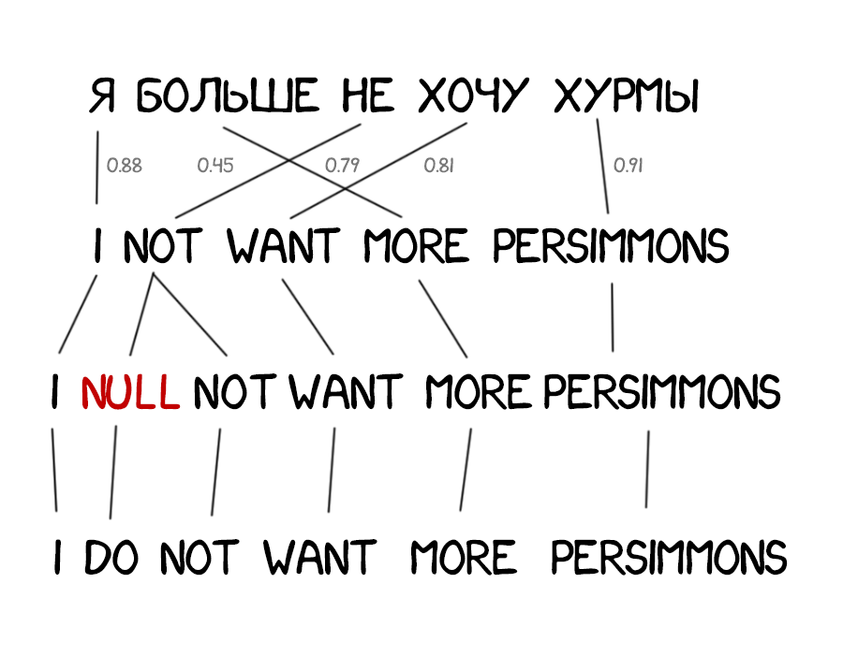
Word-based SMT (Model 3)

Slide 11
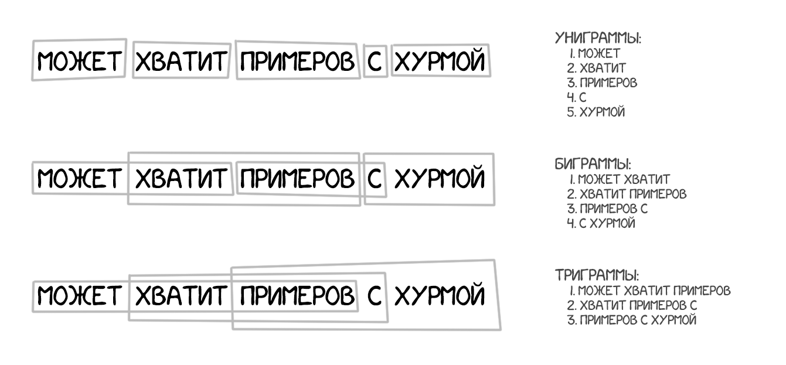
Phrase-based SMT

Slide 12
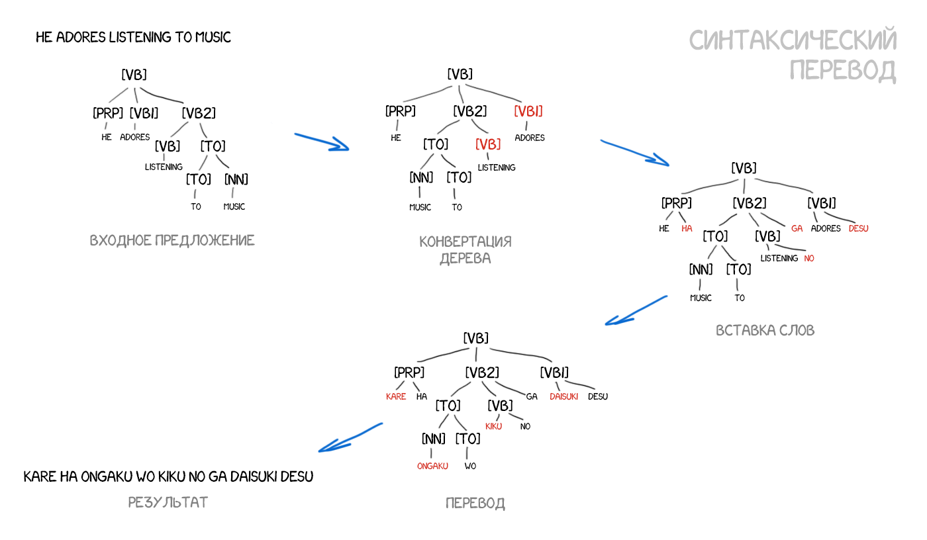

Slide 13
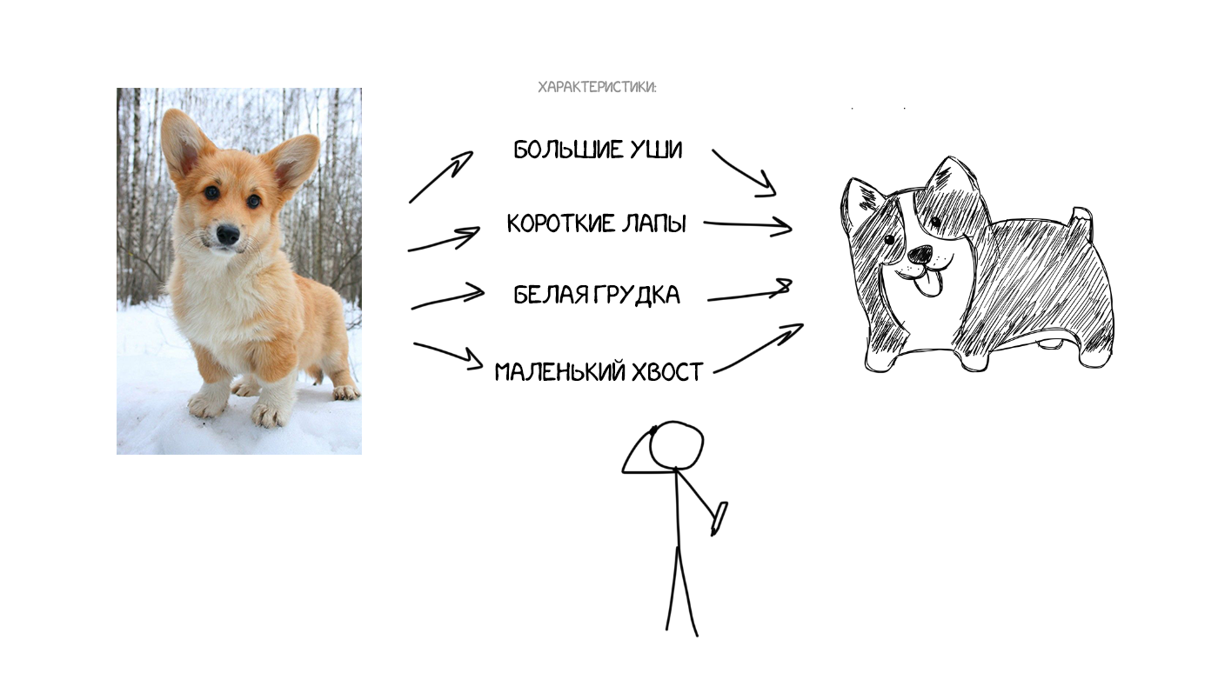
Neural Machine Translation (NMT)

Slide 14
